Slide 1
DEFENCE LAND RECORDS MANAGEMENT
Directorate General Defence Estates,
Ministry of Defence
Notes:
Sir, in the Ministry of Defence, Dte General Defence Estates is an Inter Services Organization which is primarily responsible for management of Defence Land on behalf of the MoD, to maintain defence land records and advice the Government in land policy matters.
The Defence Estates Officers, Local Military/Defence Authorities and Cantonment Boards control, protect and use land in the field as per their respective jurisdiction.

Slide 2
INDIAN DEFENCE ESTATES SERVICE
An Organised Group ‘A’ Central Civil Service
Recruitment On The Basis Of Civil Services Examination conducted by UPSC
Notes:
.

Slide 3
ORGANISATIONAL STRUCTURE
Directorate General Defence Estates
NIDEM
Directorates
Central Command Lucknow
Eastern CommandKolkata
Northern Command Jammu
Southern CommandPune
South Western Command Jaipur
Western Command Chandigarh
62 CANTT BOARDS
37 DE CIRCLES
4 ADEOs (Ind.)
Notes:
The IDES is an organized Group A Central Service, whose members are recruited on the basis of the Civil Services Examination conducted by the UPSC. The Directorate General, located at Delhi Cantonment is the Headquarters of the Defence Estates Department.
There are 06 Directorates co-located with the six Army Commands. The Directorates are headed by the Principal Directors an HAG level officers.
The National Institute of Defence Estates Management (NIDEM) located at Delhi, is the training institute for IDES officers and other staff.
At the field level, there are 62 Cantonment Boards and 37 Defence Estates Circles located at the cutting edge of administration.

Slide 4
Core Competencies
Municipal Administration of 62 notified Cantonments
Coordinating and facilitating acquisition of land
Requisitioning and hiring of Land & Buildings
Management of Defence Land
Maintenance of Records of Defence Lands
Litigation relating to land and post acquisition matters
Periodic survey of land
Defence Land Audit.

Slide 5
EXTENT OF DEFENCE LAND
Total Defence land : 17.57 lakh acres
Outside Cantonments : 15.94 lakh acres
Inside 62 Cantonments : 1.63 lakh acres
37 Defence Estates Circles and 4 Independent ADEOs
62 Cantonment Boards for land under their management
Min of Defence is the owner of all Defence Land
Excludes Hired/Requisitioned land
Defence Estates Officer plays a key role in overall management of Defence Land records
Notes:
Sir , this is the total extent of Defence Land spread all over India.The defe

Slide 6
Defence Estates Officer
Acts as agent of the Central Govt.
Custodian of defence land records
Manages defence land under his control
Responsible for hiring, requisitioning and acquisition of land and buildings
Defends Govt interest in litigation relating to defence land
Notes:
The Defence Estates Officer is an agent of the Central Government.
He is in fact the eyes and ears of the Government.
He performs a number of duties related to defence land. Important functions performed by him are shown in the slide

Slide 7
MODE OF OWNERSHIP/OCCUPATION
Ex-State Forces land
Acquisition of private land
Transfer of State Government land
Hiring
Requisition
On the basis of ‘NOC’

Slide 8
CLASSIFICATION OF LAND
Inside Cantonments
A1 Min/Def users (Army, Air Force, Navy, OFB , DRDO, etc)
A2 Vacant land for future needs
B1 Central Government other than defence
B2 State Government
B3 Land under private occupation
B4 Vacant land
C Cantonment Boards
Outside Cantonments
All land is analogous to A1
Notes:
Class A1 land is the land under active occupation of armed forces or defence organization for operational or defence purposes.
Class B-3 lands are those which have been either leased out or given under Old Grant conditions to the persons and institutions

Slide 9
SERVICE WISE LAND MANAGEMENT DETAILS
SERVICE | ACRES (in Lakh) (Approx) | % (Approx)
Army | 14.14 | 80.48
Air Force | 1.40 | 7.97
DGDE | 0.66 | 3.76
OFB | 0.47 | 2.68
Navy | 0.44 | 2.50
DRDO | 0.18 | 1.02
Others | 0.28 | 1.59
Total | 17.57 | 100
User Services are responsible for management of land including prevention and removal of encroachments

Slide 10
CLASSIFICATION OF LAND IN CANTONMENTS
CLASS | AREA (in acres) | % (Approx)
A-1 | 1,03,871 | 55.62
A-2 | 6,509 | 3.49
B-1 | 7,092 | 3.80
B-2 | 9,994 | 5.35
B-3 | 13,208 (Old Grant & Leasehold) | 7.07
C | 6,046 | 3.24
B-4 | 27,616 | 14.79
Private & Freehold | 12,394 | 6.64
TOTAL | 1,86,730 | 100.00
Notes:
Read from slide.
It may be clarified that class B-1 and B-2 are not the defence land. Together with private and freehold land, it constitutes about 29,000 acres of non-defence land within the Cantt areas.

Slide 11
ACTS AND RULES APPLICABLE IN THE MANAGEMENT OF DEFENCE LAND
Cantonments Act 2006
Right to Fair Compensation and Transparency in Land Acquisition, Rehabilitation and Resettlement Act, 2013
Public Premises( Eviction of Unauthorised Occupants )Act 1971
Works of Defence Act 1903
J & K RAIP Act 1968
J & K Land Acquisition Act 1934
Cantonment Land Administration Rules, 1925/1937
Acquisition , Custody and Relinquishment Rules 1944
Governor General in Council Orders (GGO no. 179 dt 12/09/1836 for Management of land held under Old Grants

Slide 12
DEFENCE LAND RECORDS
Land records maintained by Defence Estates Officers (DEOs) and also Cantonment Boards
General Land Registers (GLRs): Land inside Cantonments
Military Land Registers (MLRs): Land outside Cantonments

Slide 13
DEFENCE LAND RECORDS : Action for Physical Protection
Physical Protection: From Fire, Dust, Moisture, Dirt, Mishandling, Theft, Mischief
Renovation of Record Rooms all over India
Provision of Fire Proof Boxes, Fire Fighting Machinery
Provision of Compactors.
Single Point responsibility for Important Records

Slide 14
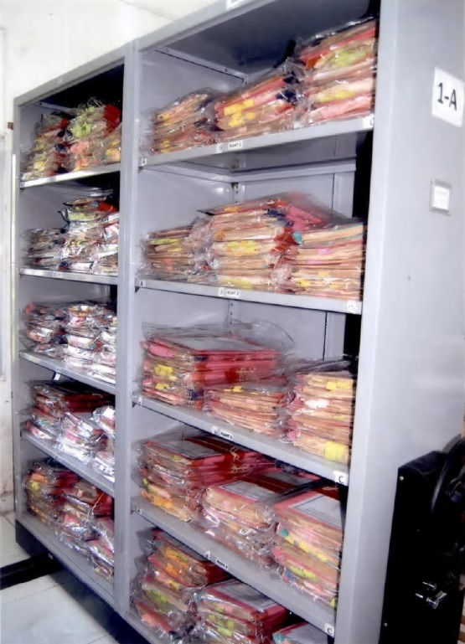
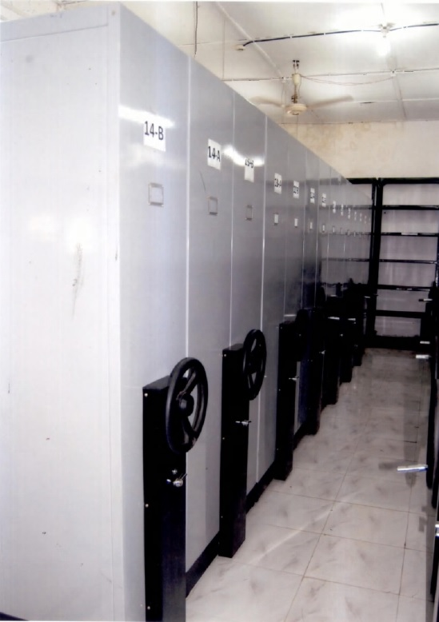
Renovated Record rooms, Compactors

Slide 15
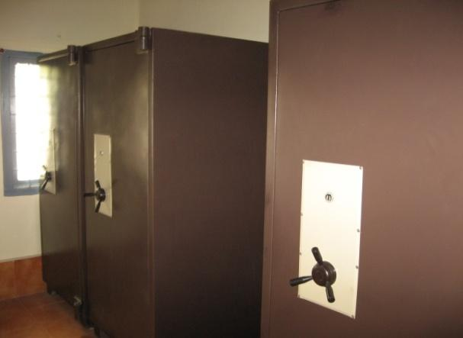
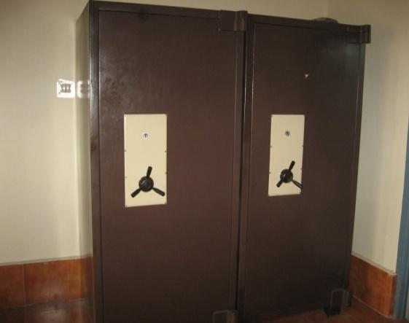
Fire Proof Boxes

Slide 16
DEFENCE LAND RECORDS : Action for Digital Protection
Project Raksha Bhoomi
Digital Replica of GLR and MLR
All data , ownership /title records including maps, encroachment details etc from physical records transported to multi layered, secured digital platform, using a specialised software called Raksha Bhoomi.
User Friendly, Easily retrievable extracts , digital signature certificates of the HOO.

Slide 17
DEFENCE LAND RECORDS : Action for Digital Protection
Online ver RB 5.0 implemented through secured MPLS-VPN of DGDE
Updated records are viewable and accessible on 24x7 basis
Next phase involves integration of records with survey generated maps with geo-referencing

Slide 18
DEFENCE LAND RECORDS : Action for Digital Protection
Information desired by applicant is just a mouse-click away.
Extract from Rakshabhoomi exactly same as in physical form.
Centralised Architecture
Disaster Recovery Server Provided

Slide 19
DEFENCE LAND RECORDS : Action for Digital Protection
Scanning /Digitization of Important Land Records other than GLR/MLR
GLRs, MLRsMaps, Admission Deeds, Old Grant Papers ,important files, Court Judgements, Lease deeds etc
Physically scanned and digitized in Tiff Image, convertible to searchable pdf
Easily searchable and retrievable

Slide 20
Scanning & Digitization
Cleaning of records
Segregation of records
Indexing of records
Scanning of Records: Phase –I
Scanning of records: Phase – II
100% completed
SCANNING OF RECORDS: PHASE – II
 | DEOs/ADEOs (41) | Cantts Boards (62)
Total Files | 30601 | 59806
Files Scanned | 24819 | 52838
Percentage of work completed | 81.11% | 88.35%
Notes:
.

Slide 21
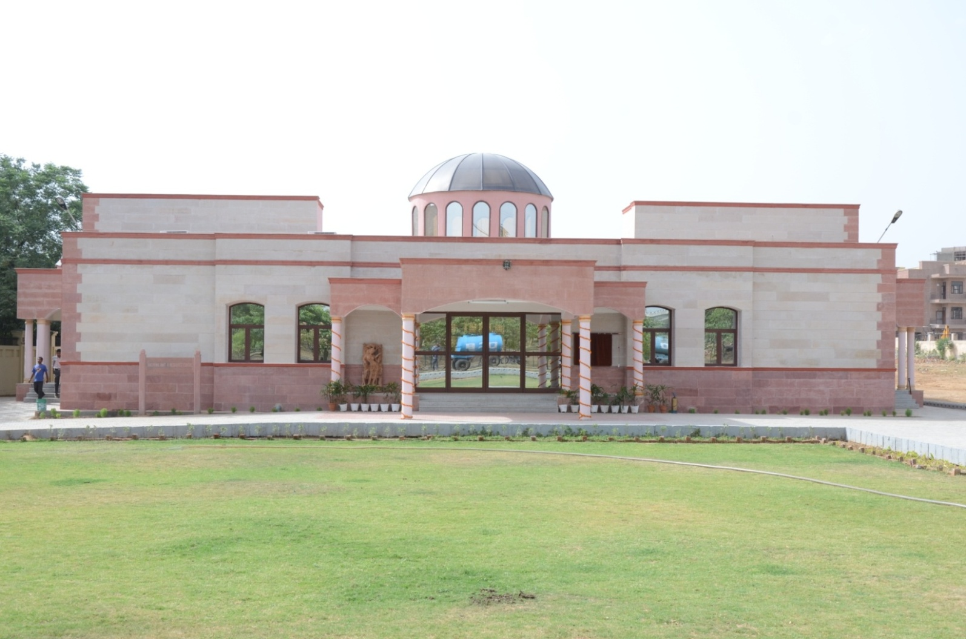
(A) ESTABLISHMENT OF AU&RC at Delhi
Another AU & RC has come up at Kirkee Cantonment
Notes:
Establishment of Archival Unit & Resource Centre at DGDE was one of the components of the Scanning and Digitization project.

Slide 22
AU & RC – CONSERVATION OF RECORDS
Progress on Conservation of Records
Estimated Records - 335 lakh pages
Damaged Records requiring
urgent repairs & restoration - 50 lakh pages
Pages repaired/ restored - 17.09 lakh
Notes:
It has been estimated that there are about 335 lakh pages under various files, registers and maps of the DEOs which may have to be preserved for a long time. This will also need repair and restoration work to about 50 lakh damaged pages.
As on date, about 15.89 lakh pages have been repaired and restored in AU & RC through contractual staff engaged for the purpose. It is presumed that the entire repair and restoration work will be completed within 5 years.

Slide 23
FUNCTIONS
Backup facility
Restoration & Conservation of Records
Advice on Record Management
Training on records management
Tie-up with National Archives (future activity)
Undertake research (future activity)
Notes:
The Back up facility has already paid of since after the recent floods in Srinagar, Chennai and Bhopal, despite the extensive damage to files and records in the DEO offices, most important files, documents and maps were retrieved through Back up data.
Two forms of back up data-
Hard copies of files, registers, maps and other documents.
Digitized version of all relevant files

Slide 24
SURVEY
Survey, Demarcation and Verification of Defence Lands. Sanctioned on 22.2.2011
Notes:
The second response is to survey, demarcate and verify defence land on ground. Raksha Mantri sanctioned a project in 2011 at a cost of Rs. 15.5 crore which aimed at survey of entire defence land in the country. The project started from Sept 2011.

Slide 25
PROGRESS OF SURVEY WORK
A. Outside Cantonments
Total Land | Work Completed | Percentage
15,92,817.86 | 15,70,617.36 | 98.61
1110 Reports submitted by DEOs and 639 have been printed

Slide 26
PROGRESS OF SURVEY WORK
Inside Cantonments
Physical Survey Completed | Reports Released | Draft Reports prepared
62 | 33 | 29
Notes:
As regards, survey inside Cantonments, it included detailed survey of land, apart from verifying boundary pillars so as to physically demarcate each survey number on ground. For this purpose, expert institutes and agencies such as IIT Roorkee, IIT Kharagpur, IIT Kanpur, Anna University, DTU, JNTU Hyderabad and WAPCOS have been hired.

Slide 27
Survey/Defence Land Details not to be shared in Public Domain
Defence Land Survey : To ensure that the Land records mirror the ground reality.
This is an internal exercise within MoD and shared with the Services.
These are the first time surveys. Many issues brought out in the reports are yet to be resolved. Hence , they can not be made public.

Slide 28
Defence Land Data Can not be put in public domain
Sanctity of defence land data may be compromised if placed on public domain or internet.
This aspect of non-sharing of defence land data in public has been conveyed by MoD to DEA after consulting the armed forces.
The survey reports, bulk land data and maps in respect of defence land are of strategic importance and can not be shared in security and national interests.
The information is always available to the authorised persons and residents through the field offices and shared by the Heads of Offices and CPIOs with individuals concerned.

Slide 29
Geo Referencing of Surveyed Maps using BHUVAN Application
Different methods/ instruments were used for Survey of Defence Land as per the requirement, resulting in digital survey maps of in different Coordinate systems .
Bhuvan is a software developed by ISRO which allows users to explore their maps or spatial data on 2D/3D based on satellite imageries. It is limited to view the data on INDIA. It also acts as a platform for hosting government data.
Following exercises are being carried out in the department with the help of NRSC Hyderabad
  Trainings for the officers and staff
  Assigning geo-coordinates to the surveyed maps using Bhuvan application in phase wise manner started in-house.
  Superimposed maps having Geo Coordinates will be integrated with Raksha Bhoomi 5.0 Land Record System.

Slide 30
Why Geo Coordinates?
Geo Coordinates are required for locating maps with Real World coordinates that can be used in Geographic Information System(GIS).
With the help of GIS many decision making system can be developed like
  Town Planning ,Infrastructure Development
  Encroachment Monitoring
  Disaster Management System development
  Mapping of Municipal services like drinking water distribution network, sewage network, Road/street development etc.
  Collection of taxes, sanctioning of building plans etc.

Slide 31
Integrating survey maps with Geo Coordinates with the help of BHUVAN (Medak and Secunderabad)

Slide 32
THANK YOU

